Slide 1
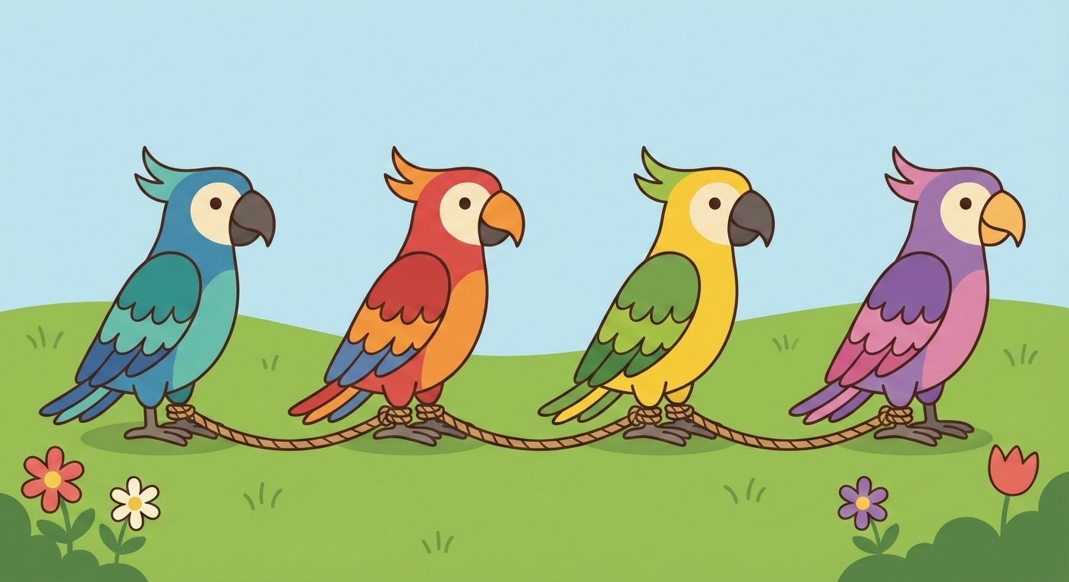

Agentic AI with LangChain and LangGraph
Presentation 7: Some Advanced Topics of LangGraph
Primary Instructor: Michael Z
RA: YH
Date: 2026.Jan-Feb

Slide 2
0. Local LangGraph App

Slide 3
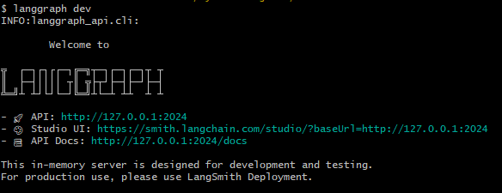
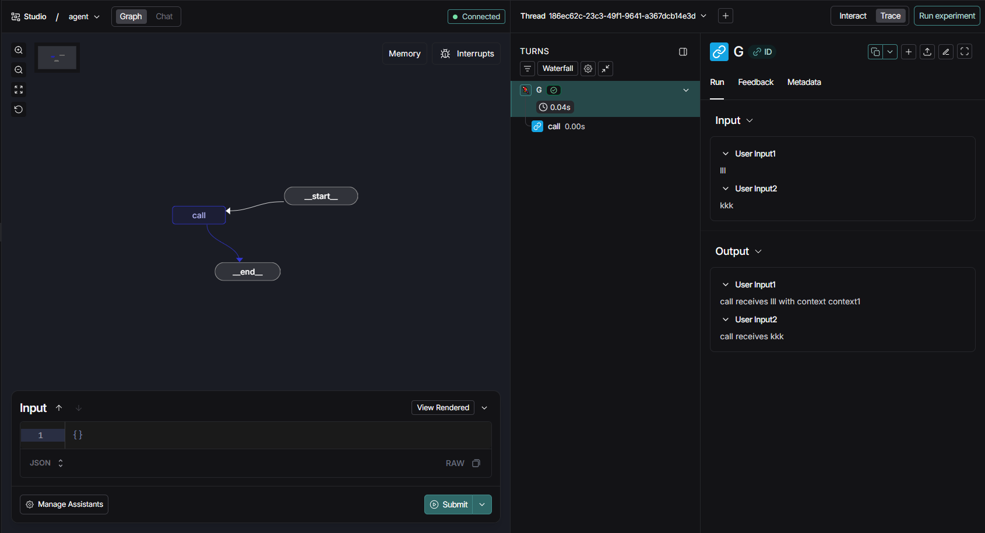
0. Local LangGraph App
As the multi-agent/agentic workflow application you made is becoming bigger and bigger, more and more complex, it’s really hard to keep track of what’s going on inside every single node.
Therefore, you could run LangGraph app locally to catch every single operation inside your app, such as tool’s input and output. It could preserve every run you submitted.
You need langsmith api key to run this app successfully. No credit card info is needed.
It’s suggested to follow my guide to make it work.
You might run into some issues when playing with other templates. The key is to upgrade langgraph-api:
uv pip install -U langgraph-api

Slide 4
0. Local LangGraph App: App Structure
I would go over this doc:
https://docs.langchain.com/oss/python/langgraph/application-structure
And talk about what I see from the project

Slide 5
1. Interrupts (aka HITL)

Slide 6
1. Interrupts: More flexible than HITL
Go over the following for you:
https://docs.langchain.com/oss/python/langgraph/interrupts

Slide 7
2. Agent Chat UI

Slide 8
2. Agent Chat UI: Watch the video
https://www.youtube.com/watch?v=lInrwVnZ83o

Slide 9
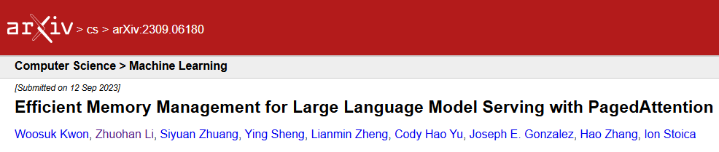
Thank you for your paged attention!

Slide 10


